Slide 1


Can Subsidized Housing Help Address Homelessness in New England?
Robert Clifford and Osborne Jackson
November 18, 2015
New England Public Policy Center
Federal Reserve Bank of Boston

Slide 2
Overview of findings
The number of sheltered homeless families in Massachusetts and Vermont is on the rise, driving an increase in measured homelessness in New England.
LIHTC developer incentives lead to more projects in New England and larger projects outside the region.
The majority of evidence suggests increases in subsidized housing are likely to reduce local homelessness, particularly in New England.

Slide 3
Definition and Measurement
Current federal definition, updated in 2009:
  Literal homeless: Unsheltered and sheltered (e.g., emergency shelter and transitional housing)
  Vulnerable or at-risk populations: Losing their primary nighttime residence, including those living in a motel/hotel or “doubled-up” situations.
  Defined under other federal statutes: Includes unaccompanied youth or families with children and youth.
  Domestic violence: People who are fleeing or attempting to flee domestic violence.
Measurement: HUD Point-in-Time Estimates (PIT)
  A one night snapshot of the literal homeless conducted in January.

Slide 4
Rising homelessness in New England is driven by higher rates of sheltered families

Slide 5
Why is family homelessness on the rise in New England?
Three potential hypotheses:
  National market forces interacting with area-specific shelter policies.
  Area-specific market forces.
  Measurement differences among homeless subpopulations.

Slide 6
Area-Specific Shelter Policies
Massachusetts is the only state with a “right to shelter.”
  Stems from a law passed in 1983 that has been revised multiple times in the past 30 years.
  Currently, the state provides targeted emergency shelter assistance, subject to appropriations, for needy families with children and pregnant women.
Vermont General Assistance and Cold Weather Exemption
  General Assistance: Provides emergency housing for up to 28 days for vulnerable populations such as the elderly, disabled, and families with children or pregnant women.
  Cold Weather Exemption: Allows homeless families and individuals access to shelter on severe winter weather days.
Policies are not new or unique, as New York City and Washington, DC have similar policies in place.

Slide 7
Rates of homeless sheltered families are rising in targeted shelter policy areas
Homeless per
10,000 Residents

Slide 8
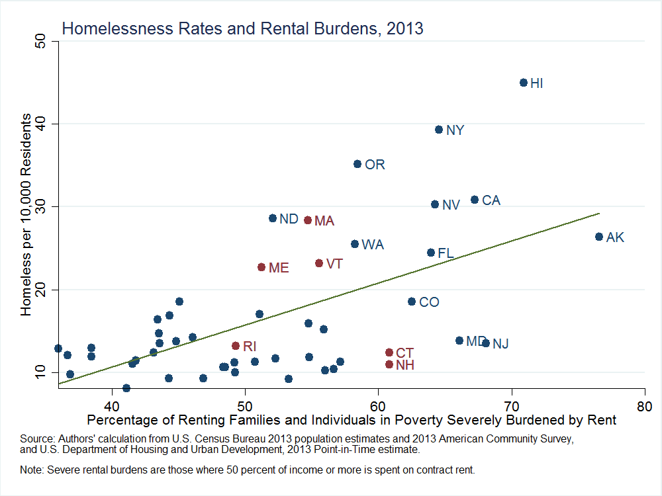
Relationship between homelessness and housing burdens is weak in New England

Slide 9
Measurement error: the unsheltered homeless population is difficult to count
The PIT count is conducted in January “because it is easier to count people in shelters than on the street or in other places not meant for human habitation...” (HUD 2008).
Researchers (e.g., Corinth 2015) have also noted the difficulty in counting the street population due to:
    Individuals avoiding the counts
    Difficulty covering large areas
    Differing count methodologies
    Laws criminalizing homelessness
Undercounted or missing unsheltered homeless populations can lead to misinterpretations of rising levels of sheltered homeless (e.g., compositional shifts).

Slide 10
A role for subsidized housing?
Legislation passed by the U.S. Congress in 2009 amending the definition of homelessness included this statement: “a lack of affordable housing and limited scale of housing assistance programs are the primary causes of homelessness.”
The extent to which such assistance can help to alleviate homelessness is dependent on:
  The demand for low-income housing by the homeless.
  The supply of such housing through federal and state programs.

Slide 11
The homeless are composed of many different subpopulations

Slide 12
LIHTC is the largest and fastest growing project-based subsidized rental program

Slide 13
The Low-Income Housing Tax Credit
Created under Tax Reform Act of 1986.
Provides tax incentive to develop rental units targeted at low-income (LI) households.
    Developers obtain credits through competitive process.
    Dollar-for-dollar reduction in tax liabilities over 10 years.
    Rent limits on LI units (≤ 18% of area median income).
Projects in Qualified Census Tracts (QCTs) receive thirty percent more credits.
    LIHTC activity may jump once QCT eligibility threshold crossed.
    Creates a quasi-random experiment in housing placements.
    Examine impact of LIHTC development on local homelessness.

Slide 14
Importance of a quasi-random experiment
Allows location of development sites to be unrelated to neighborhood traits like poverty or unemployment.
Without random housing placement, sites may be selected due to local factors also affecting homelessness.
Difficult to isolate the impact of subsidized housing on homelessness without a (quasi-)random experiment.

Slide 15
Example: comparing neighborhoods
Tract A: 5 projects, 20 homeless, 10% poverty.
Tract B: 15 projects, 70 homeless, 25% poverty.
True effect of subsidized housing on homelessness:
    Assume: 1 project → 10 fewer homeless.
      If Tract A had 6 projects, there would be 10 homeless individuals.
      If Tract B had 16 projects, there would be 60 homeless individuals.
Estimated effect of subsidized housing on homelessness:
    Comparing tracts A and B: 1 project ←→ 5 more homeless.
    Problem: project placement related to homelessness (not random).
      Link may be direct, indirect via poverty, or via some other observed or unobserved factor(s).

Slide 16
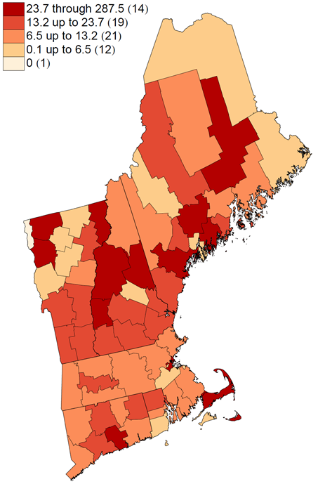
Homelessness rates vary across areas of New England
New England County 2000 Homelessness Rates, per 10,000 Residents
Source: 2000 U.S. Census.
Note: “To” excludes the value listed afterwards, while “through” includes the value listed afterwards. Number of counties in each category listed in parentheses.

Slide 17
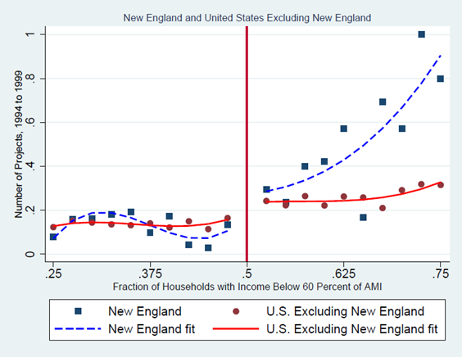
QCT eligibility induces developers to provide more subsidized housing
Impact of QCT Eligibility on LIHTC Development
QCT Eligibility Threshold
Source: U.S. Department of Housing and Urban Development LIHTC data and QCT eligibility data and authors’ calculations.
Note: A tract is QCT-eligible when at least 50 percent of households have incomes below 60 percent of AMI. In the figure, tracts are categorized by percentage of eligible households and are grouped into 2.5 percentage point bins.

Slide 18
Developer response to QCT eligibility differs by region
Within New England:
  More LIHTC projects: 0.25 more projects (157% increase in average tract), mostly through rehabilitation (81%).
Outside of New England:
  Larger LIHTC projects: 6.2 more units (68% increase in average tract), mostly through new construction (65%).
Use quasi-random local housing development to estimate impact on neighborhood homelessness.
  Projects (NE) and units (non-NE).
  Link via unit-project ratio in average tract (57 units per project).

Slide 19
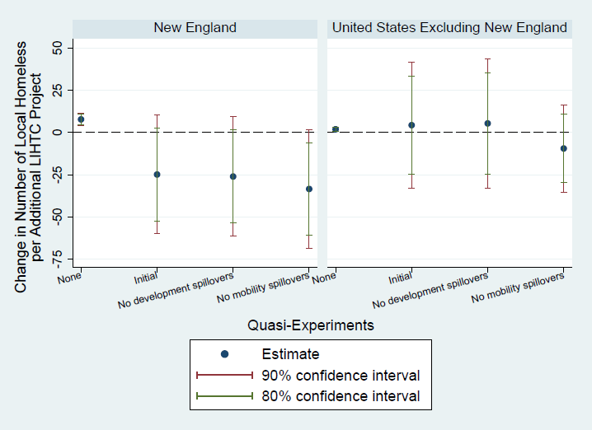
Accounting for mobility, subsidized housing likely reduces local homelessness
Impact of LIHTC on Neighborhood Homelessness Estimated under Various Scenarios
Source: U.S. Department of Housing and Urban Development LIHTC data and QCT eligibility data, U.S. Census data, and authors’ calculations.

Slide 20
Conclusions
Large increases in the number of sheltered homeless families in Massachusetts and Vermont are driving up measured homelessness in New England.
LIHTC developer incentives lead to more rehabilitation projects in New England and larger new construction projects outside the region.
Bulk of evidence suggests subsidized housing is likely effective at reducing neighborhood homelessness, particularly in New England.

Slide 21
Caveats and discussion
Impact of subsidized housing in moderately-poor tracts.
    Outcomes may differ in very rich or very poor neighborhoods.
LIHTC-specific program features may play a role.
    Share of projects targeted to the homeless.
Results for a supply-side housing program may differ from a demand-side program.
    Rent and income limits tied to area (supply) vs. person (demand).
Further work also needed on alternative hypotheses (e.g., area-specific shelter policies) to understand relative importance of local housing market forces.

